Slide 1


MLOPS Automation of Machine Learning model through Jenkins and Docker for better accuracy.
TASK – 03
BY GAURAV MALIK and SRIDHAR RAO

Slide 2
JENKINS JOBS
JOB-01
JOB-02
JOB-03
=> Pull the GitHub repo automatically when some developer push repo to GitHub
=> By looking at the code Jenkins should automatically start the docker image container to deploy code and start training
=> Train the model and predict the accuracy

Slide 3
JOB-04
JOB-05
JOB-06
=> If metrics accuracy is less than 80% then tweak the machine learning model architecture
=> Retrain the model or notify that the best model is being created
=> If any container where app is running fails due to any reason then start the container again from where the last trained model left

Slide 4
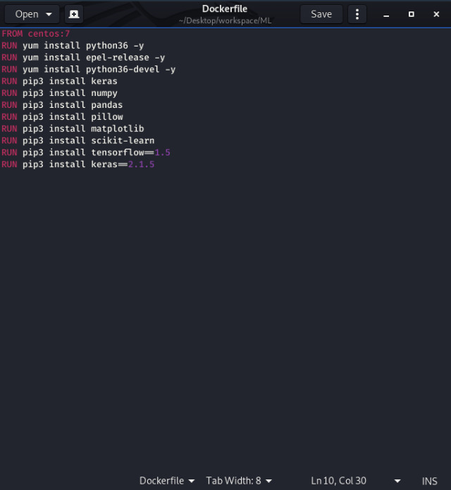
Dockerfile

Slide 5
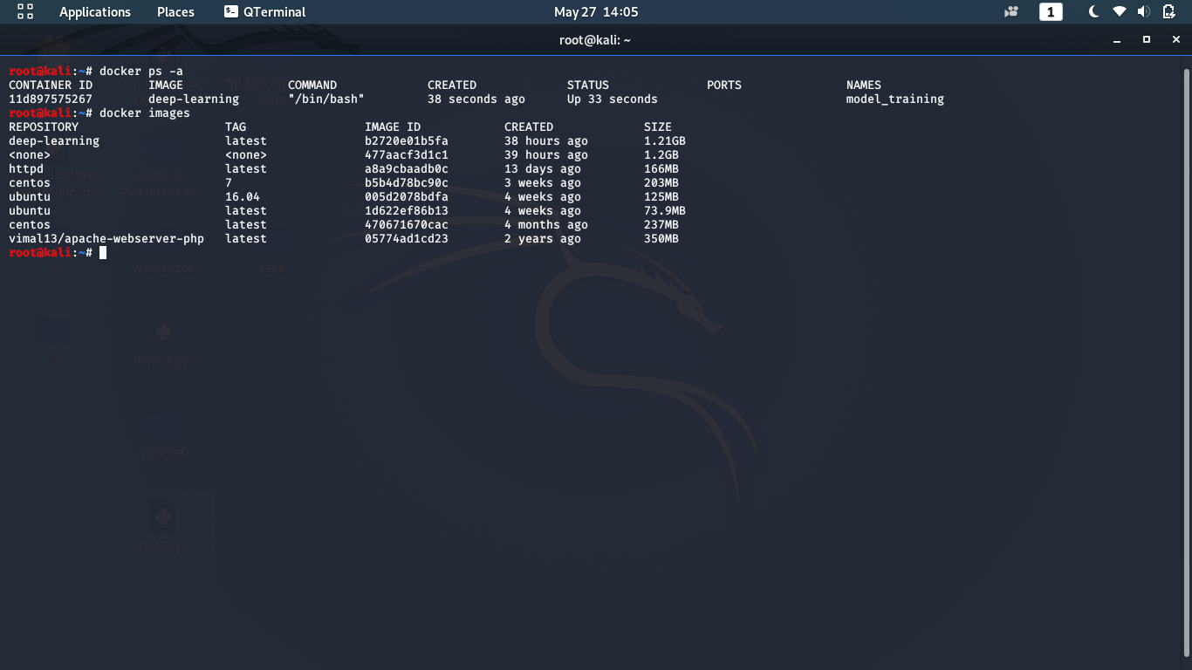
Created Docker Image

Slide 6
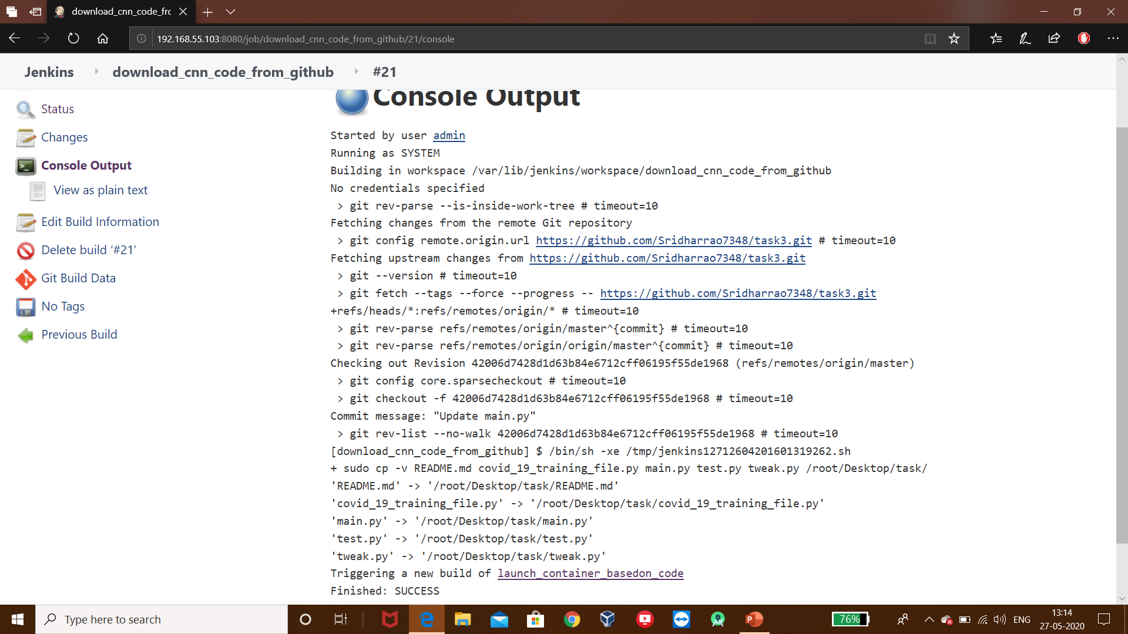
Downloading Repo From Github

Slide 7
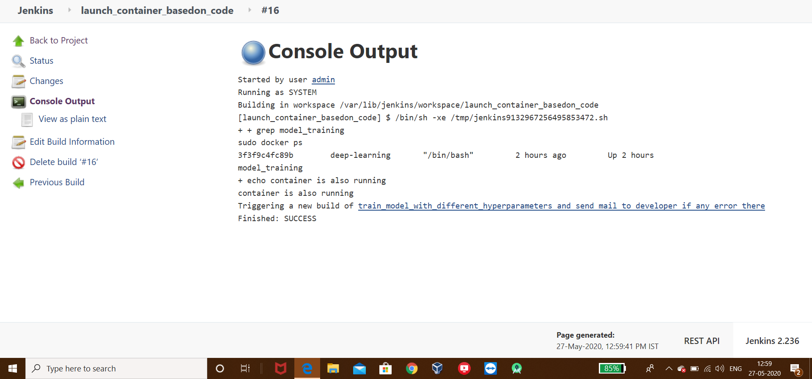
Launching Corresponding Container

Slide 8
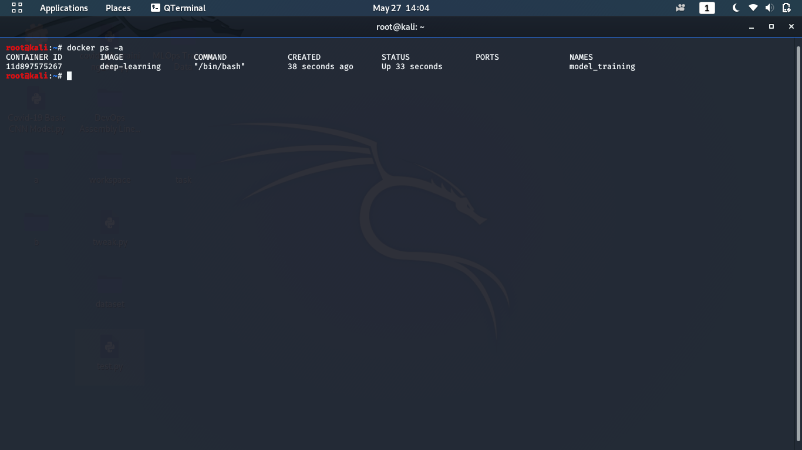
Docker Container started Successfully

Slide 9
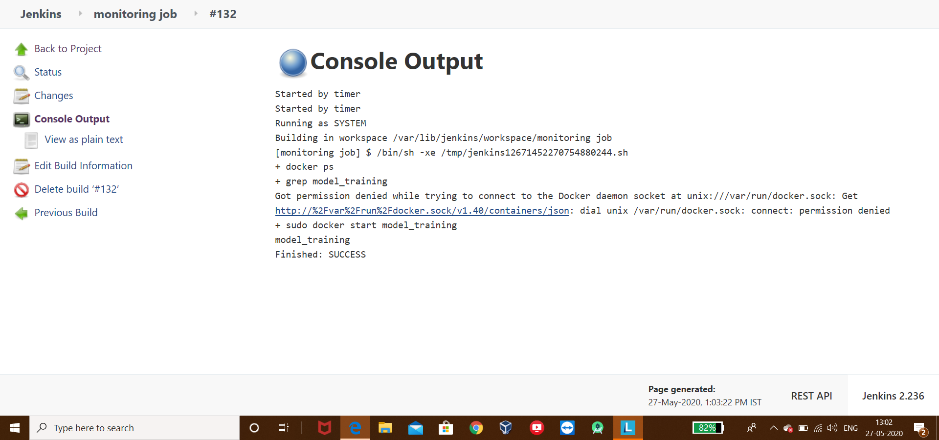
Monitoring Job

Slide 10
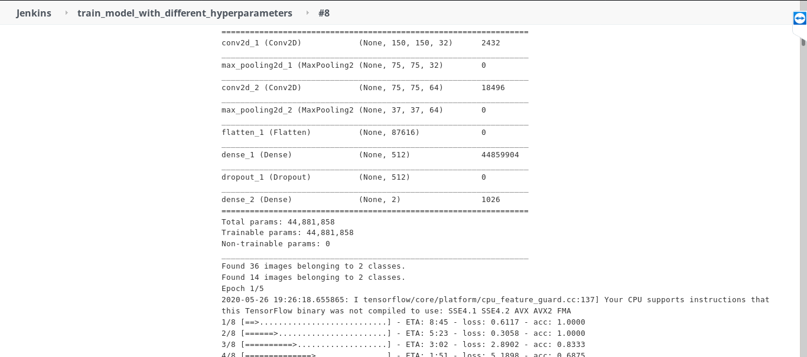
Training The Model

Slide 11
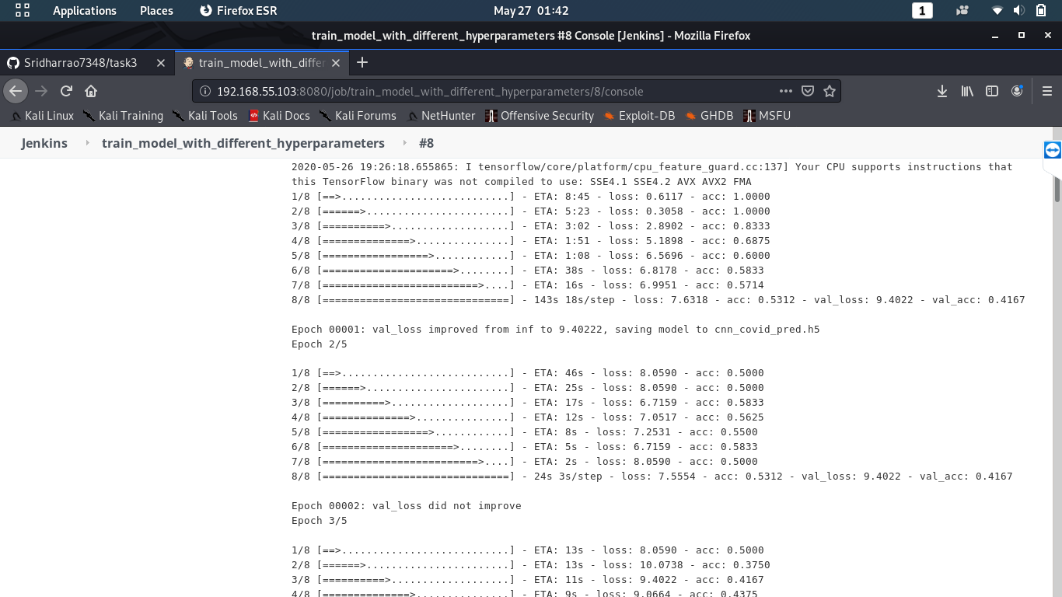

Slide 12
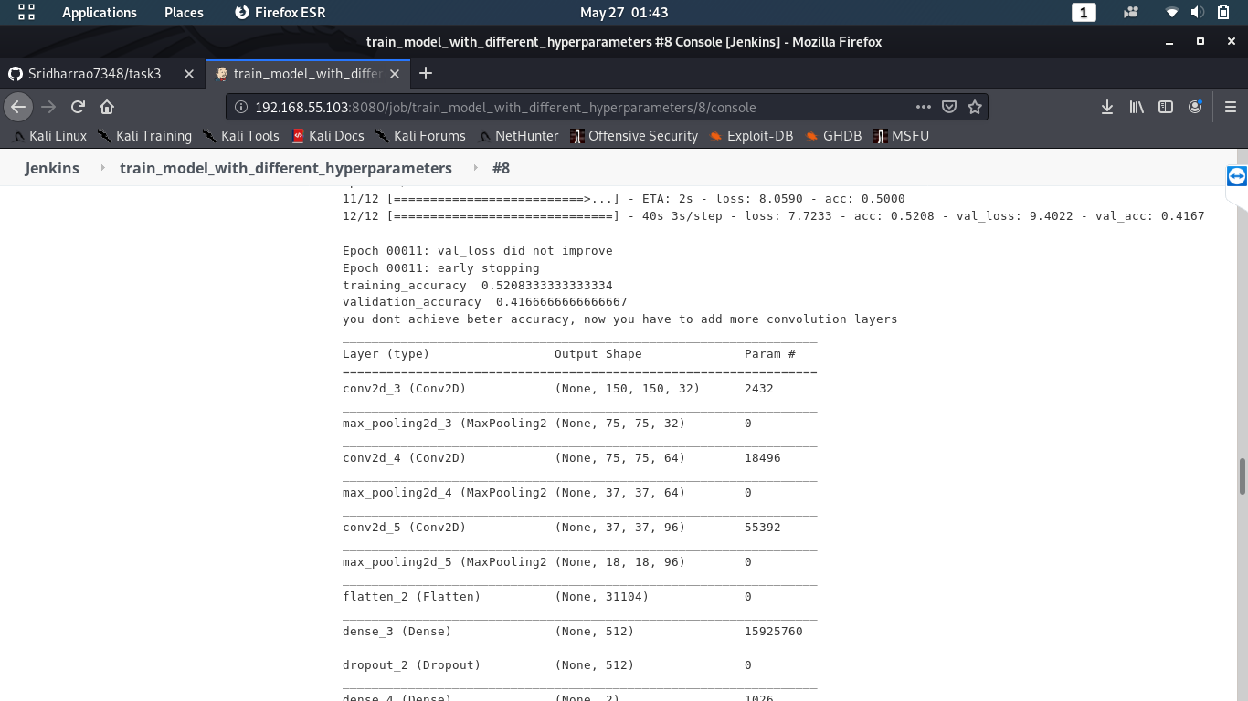
Got Less Accuracy

Slide 13
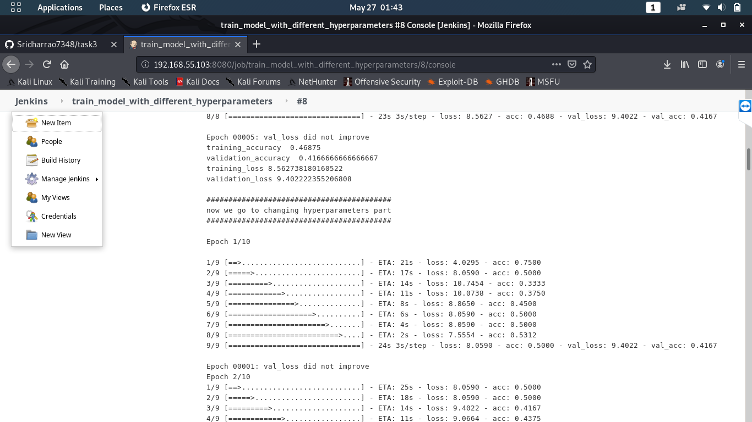
Tweaking The Machine Learning Model

Slide 14
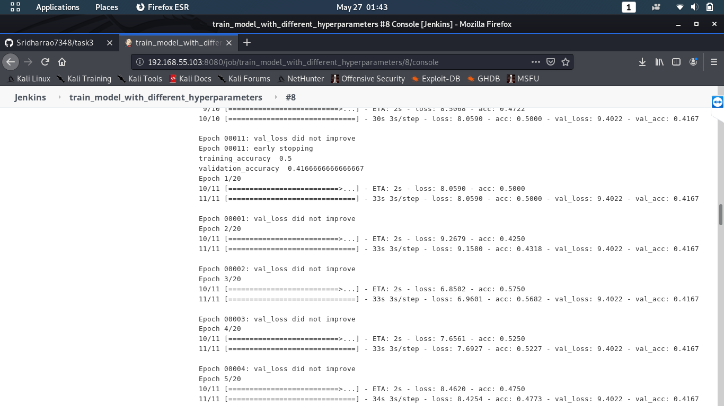
Increased Epoch To 20

Slide 15
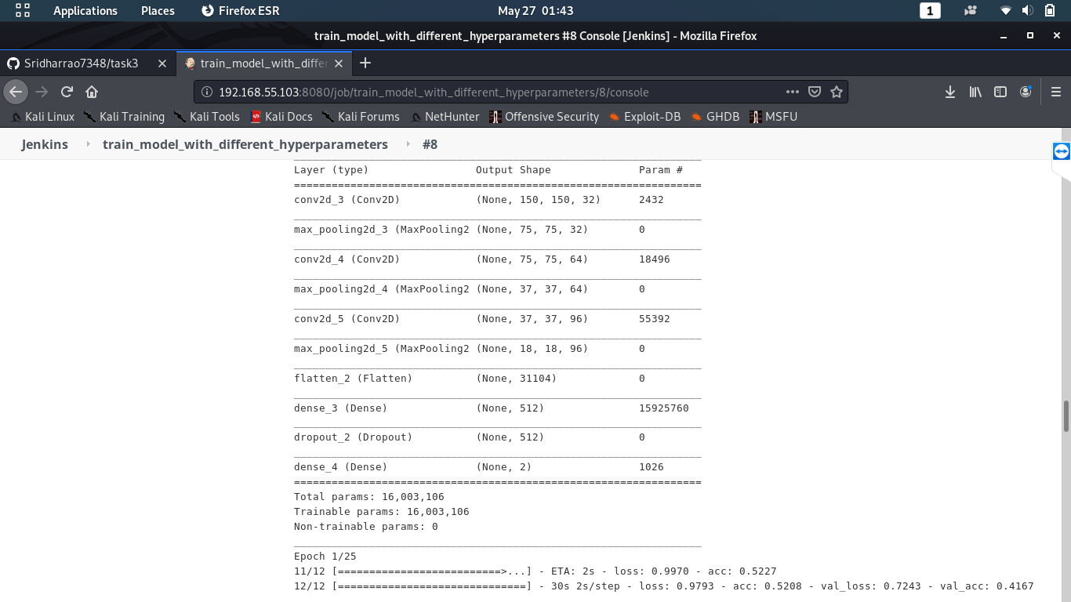
Added More Layers And Increased Epoch To 25

Slide 16
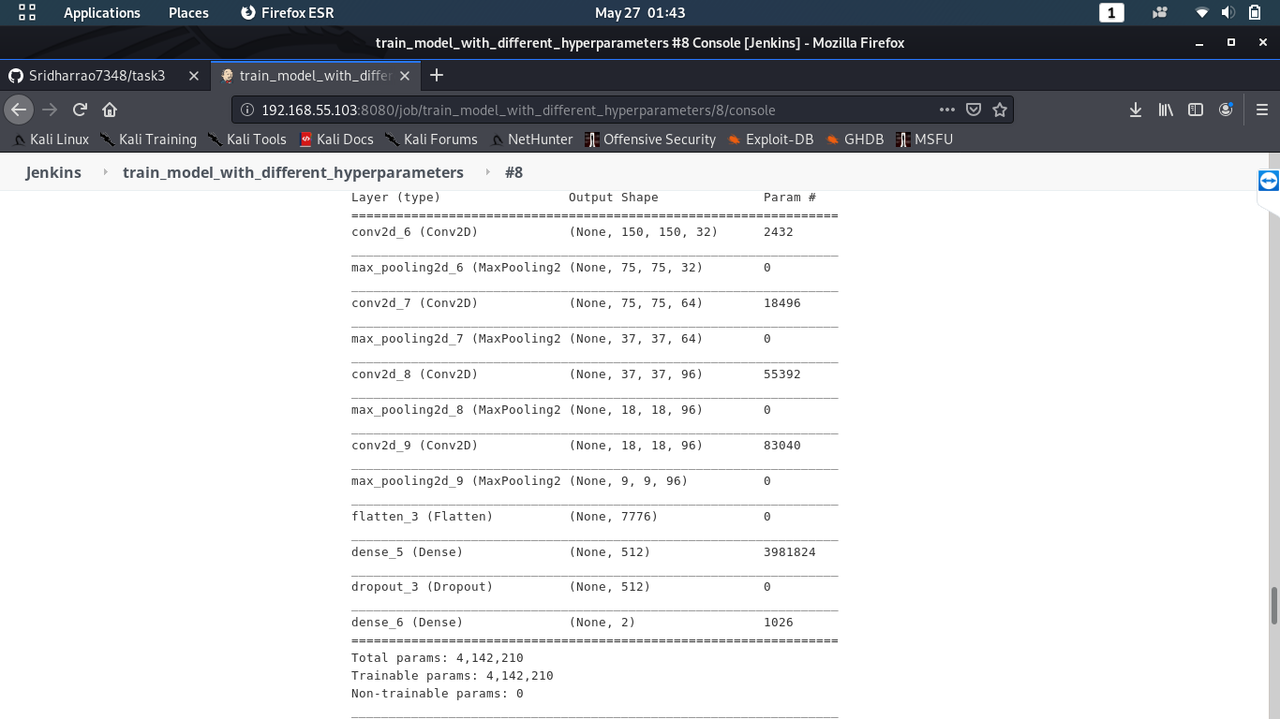
Added More Layers

Slide 17
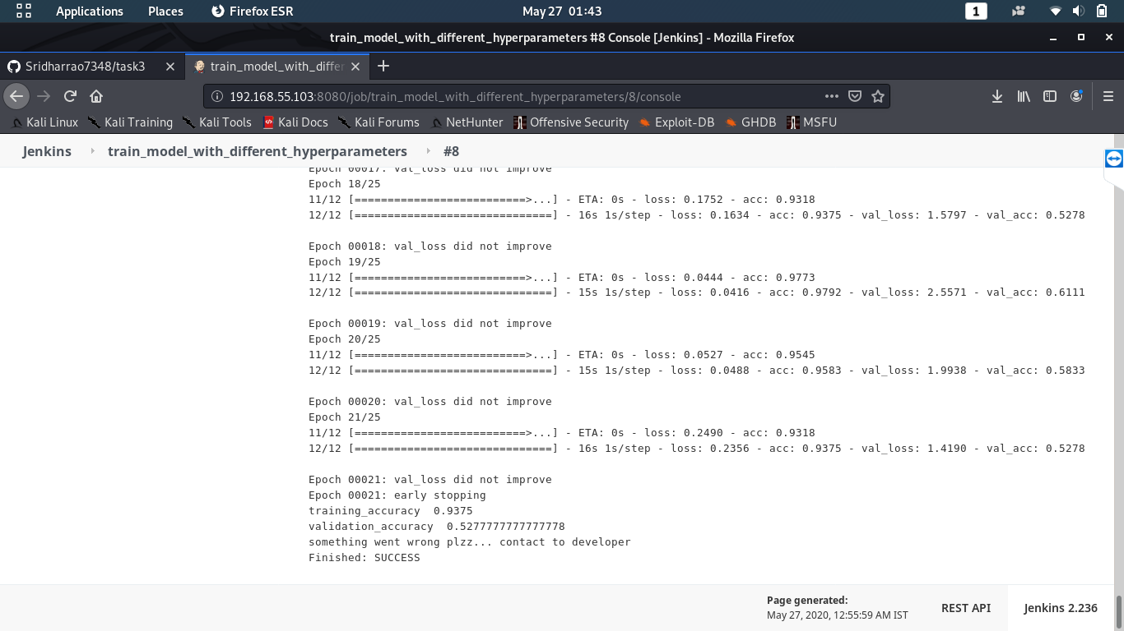
Accuracy Improved To 93 From 52

Slide 18
Please ensure that the model tweaked and added more layers and epoch because of less accuracy and until last step accuracy was very low

Slide 19
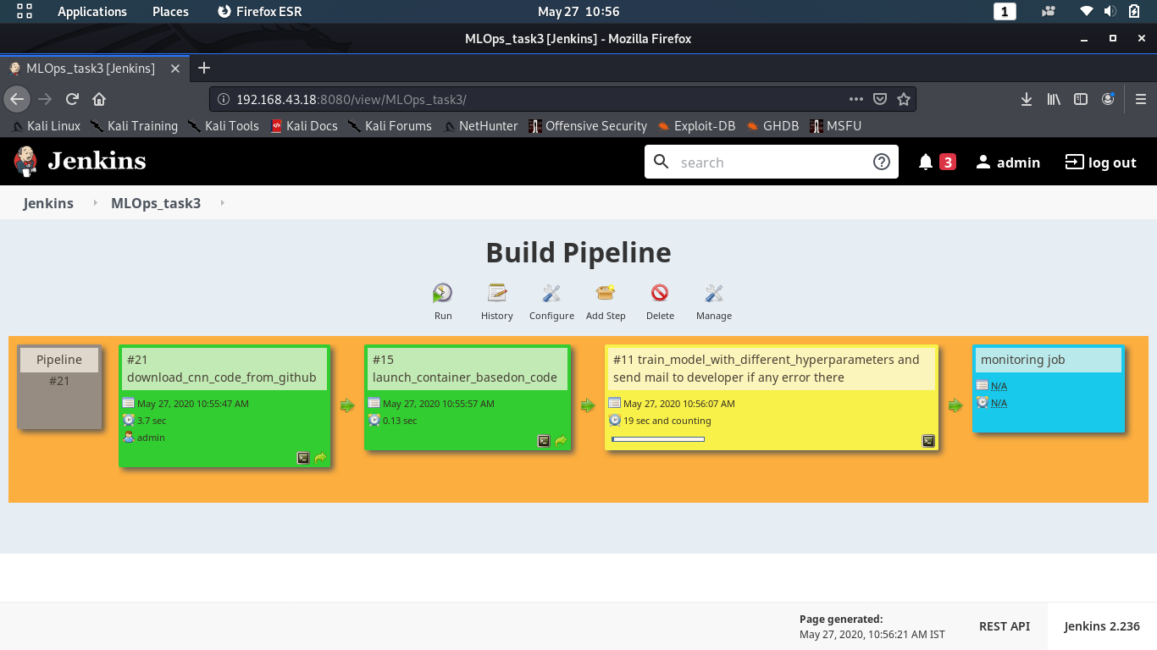
Pipeline Of All Jobs

Slide 20
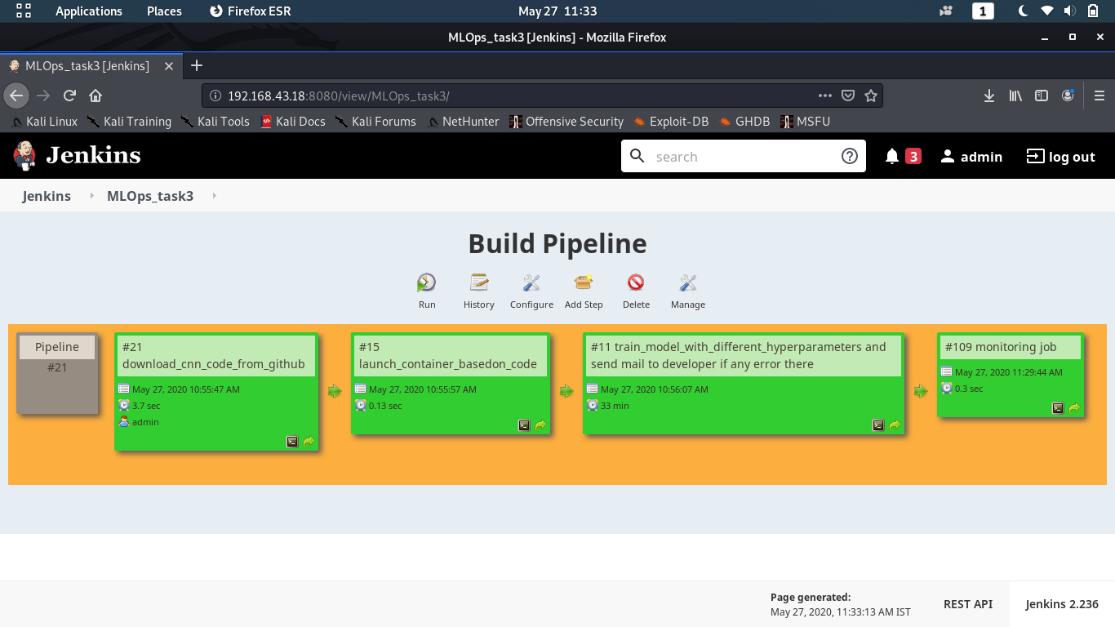
SUCCESSFULLY COMPLETED

Slide 21
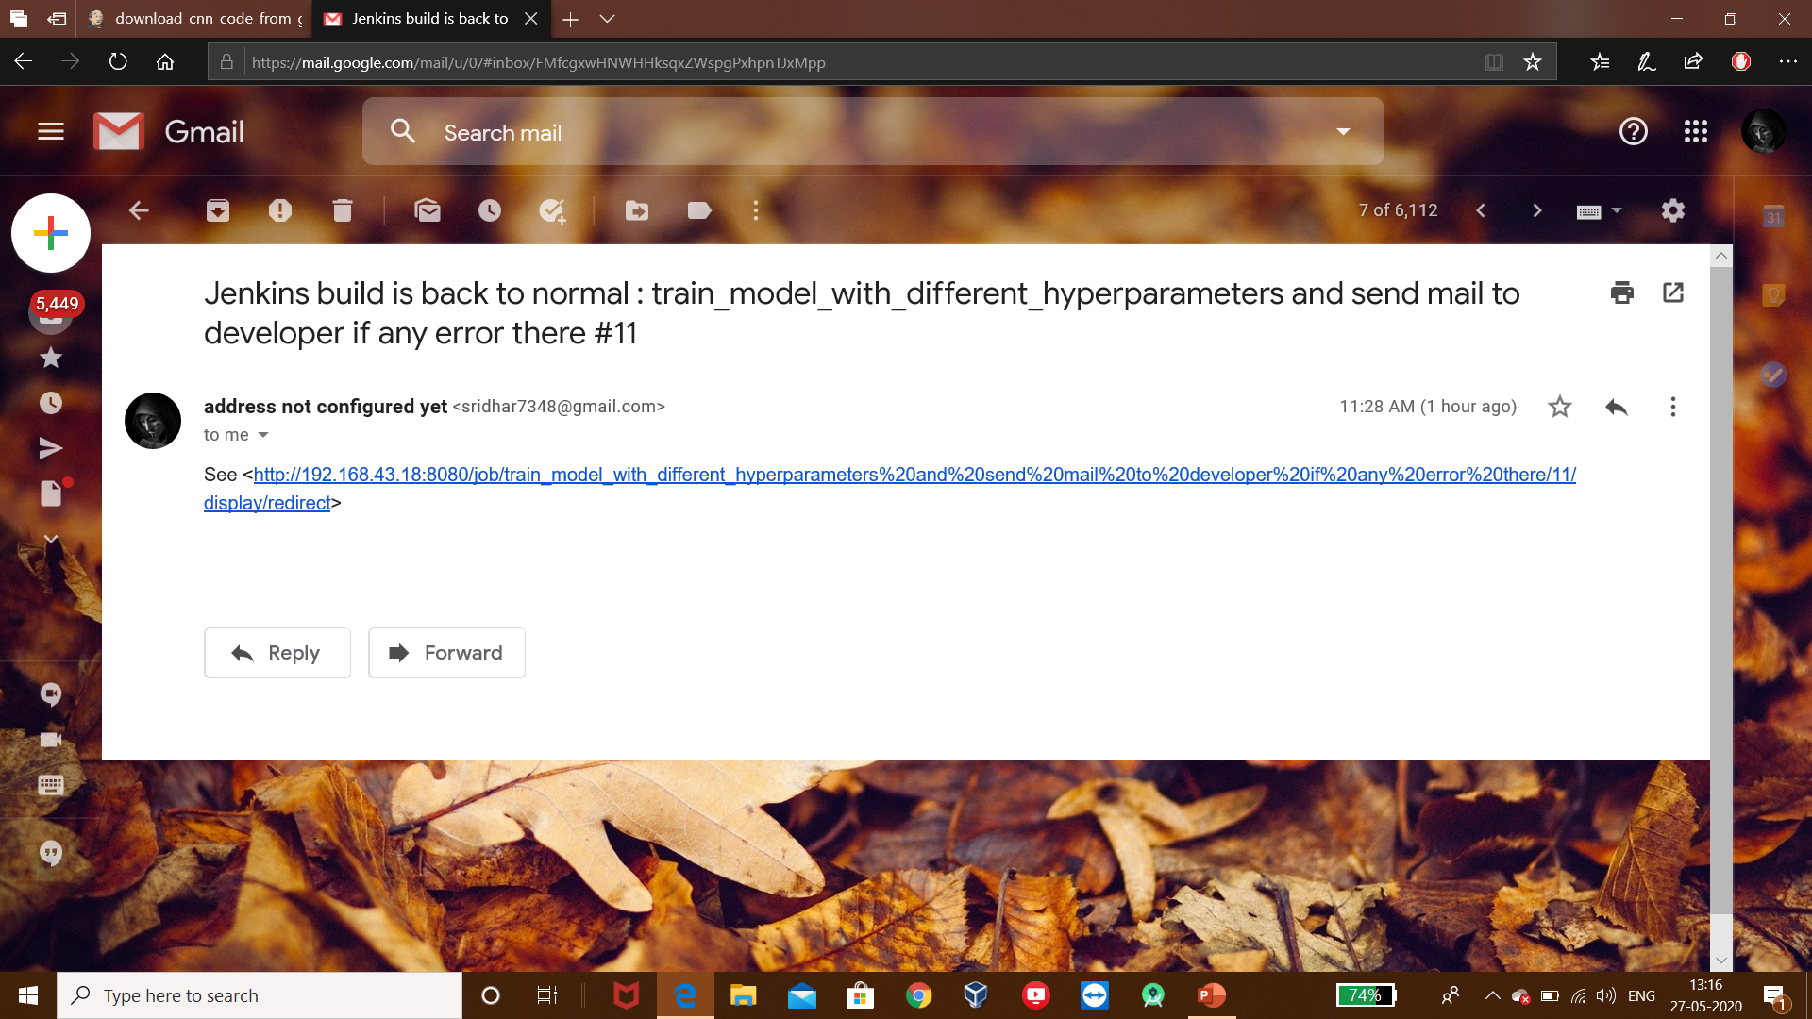
Got Mail After Successful Built

Slide 22


